Slide 1


Robotics Workshop Week 8 MP3 Player

Slide 2
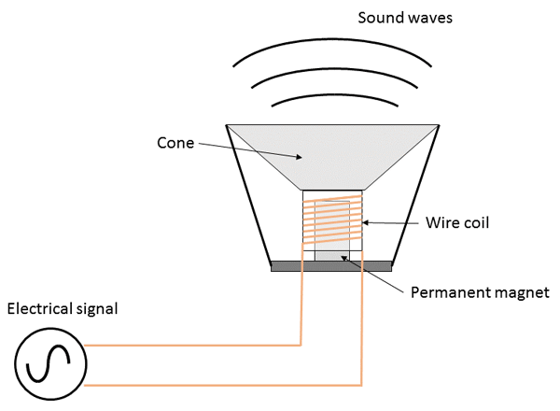
Speakers

Slide 3
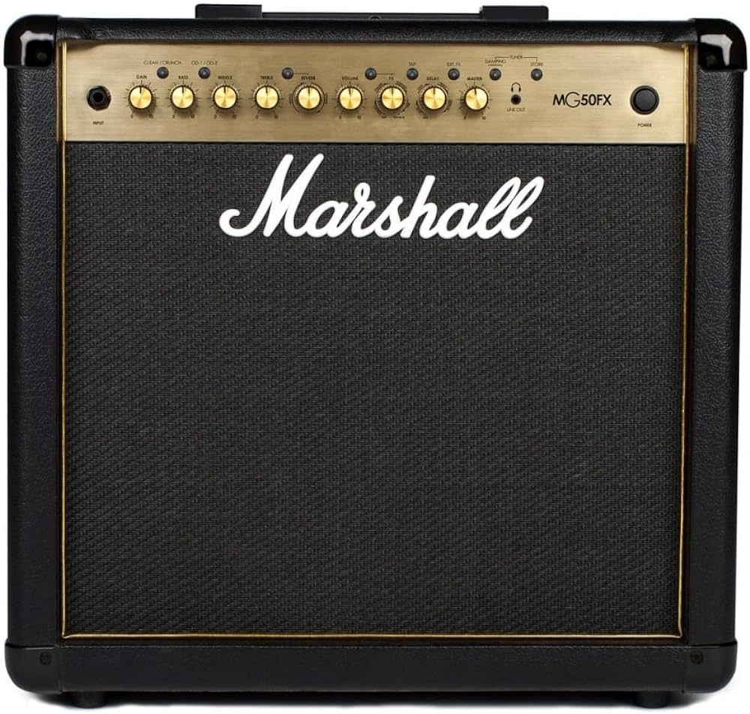
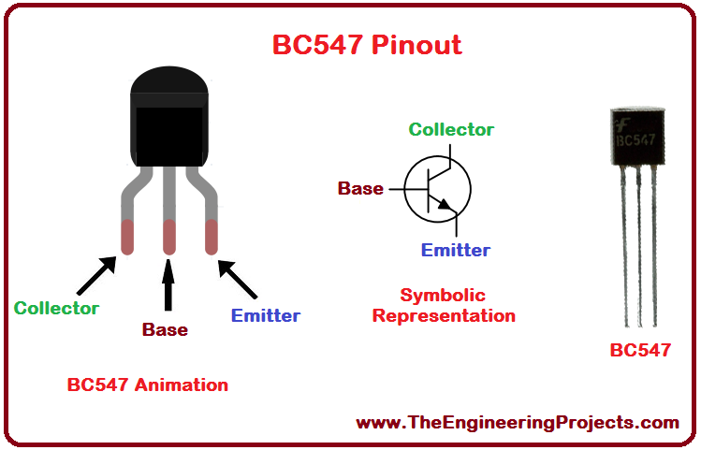
Transistors
Basic component for an amp

Slide 4
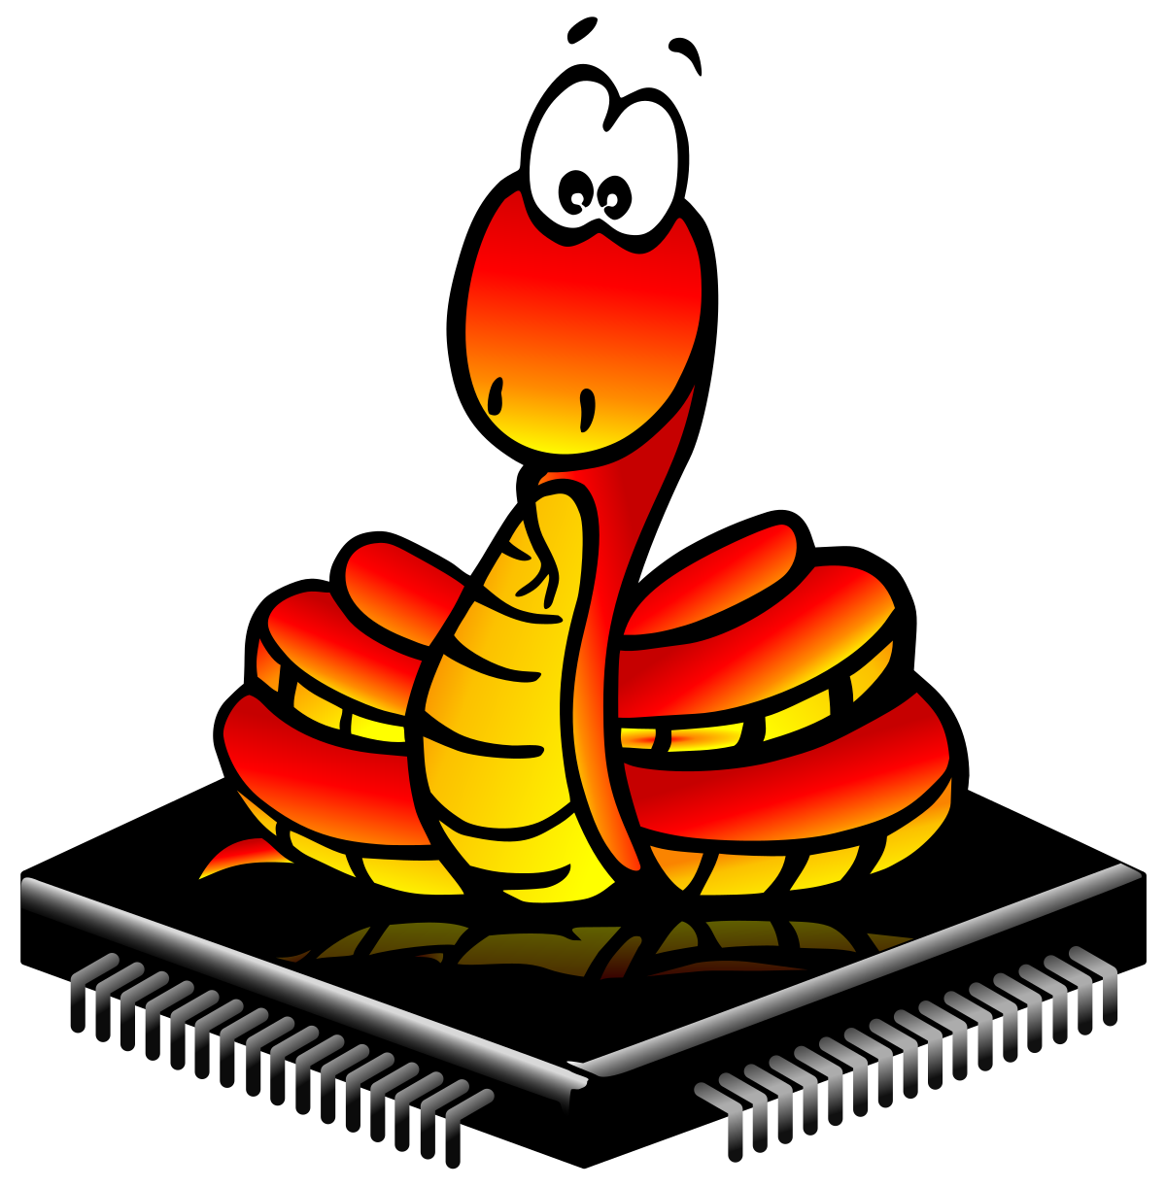
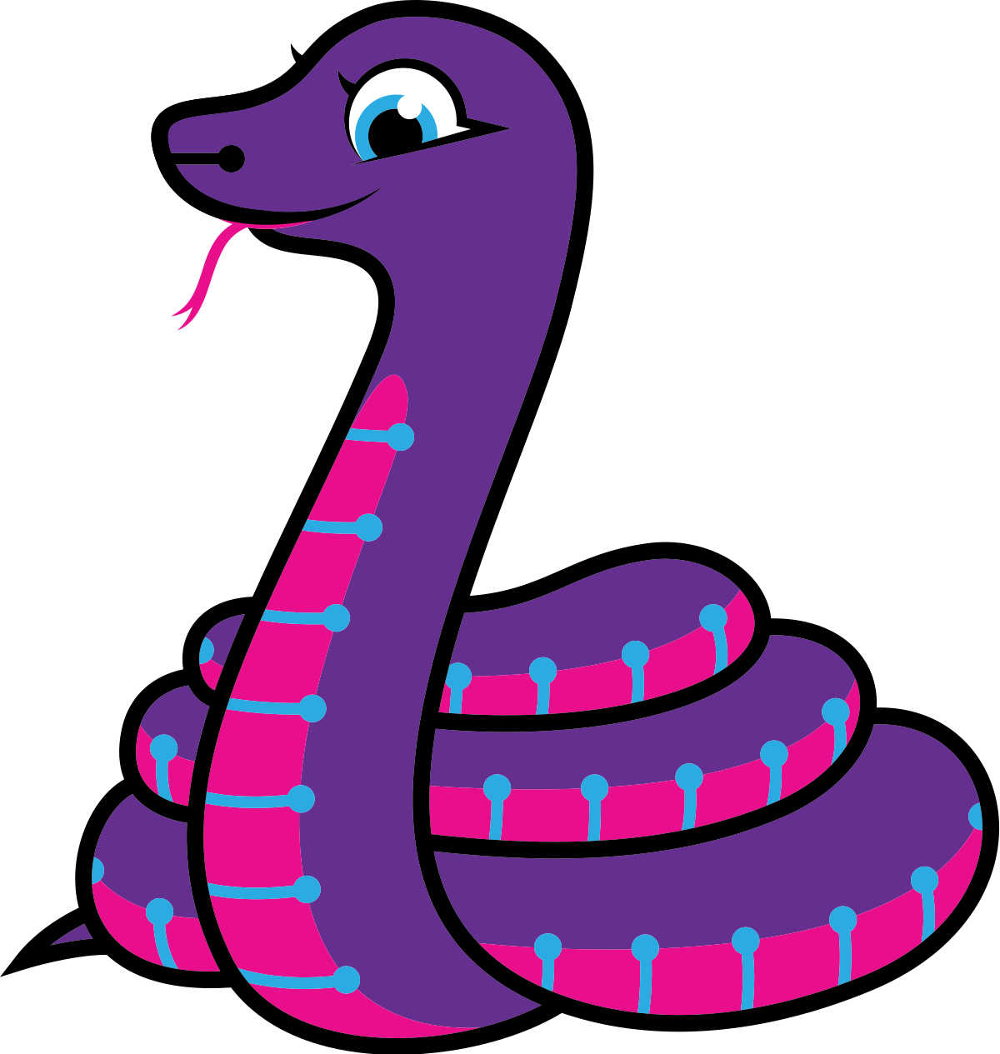
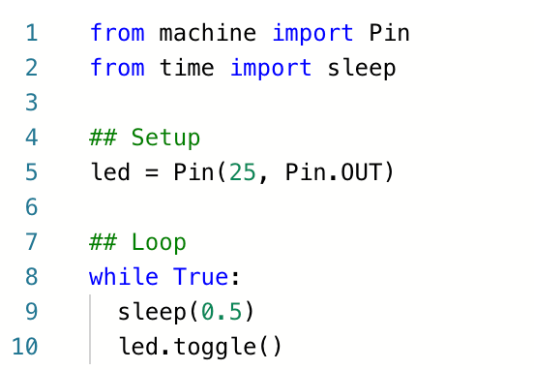
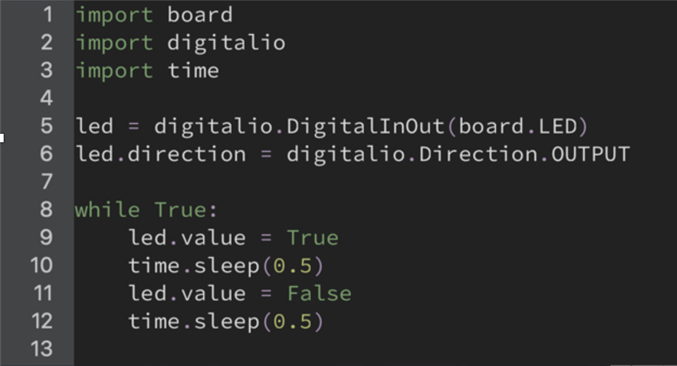
CircuitPython VS MicroPython
An open source fork of MicroPython
Has the audio modules we need
Notes:
Does anyone want have a go at explaining what a micro-controller is? No? ok.
A micro controller is a small device that lets you program and control its inputs and outputs in the form of electrical signals. All of these are different types of micro-controllers. We’ll be using the one on the left called a Raspberry Pi Pico.
All of those golden tabs can be connected to wires, and then controlled with code.

